Slide 1
Mathematical Methods of Uncertainty Quantification in Hydrology
Assignment 1,2 & 3: Parameter Optimization, Local Sensitivity Analysis & Global Sensitivity Analysis
Group 1: Adrien Thébault, Vincent Taneli Olander, Nafisa Raihana

Slide 2
Parameter Optimization

Slide 3
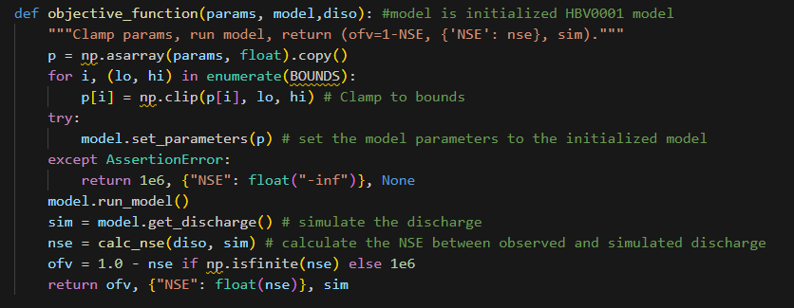
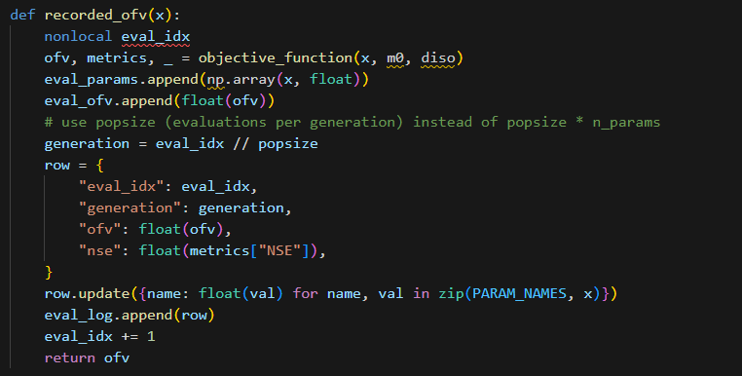
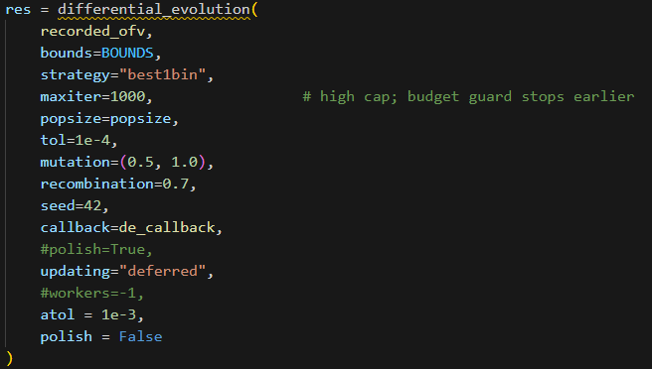
Parameter Optimization
Original Code

Slide 4
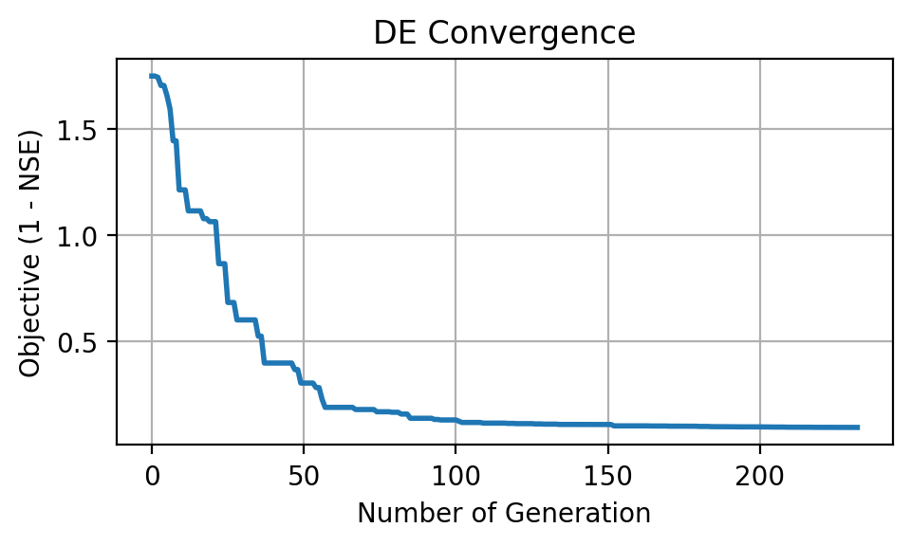
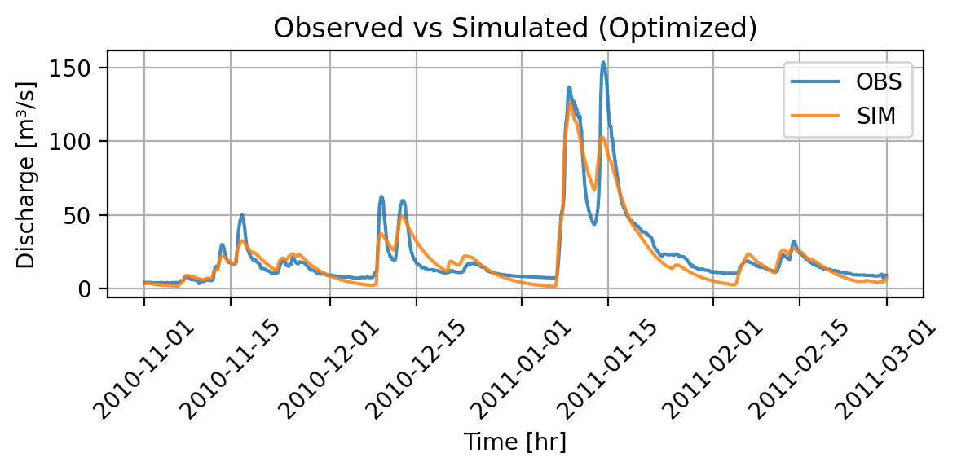
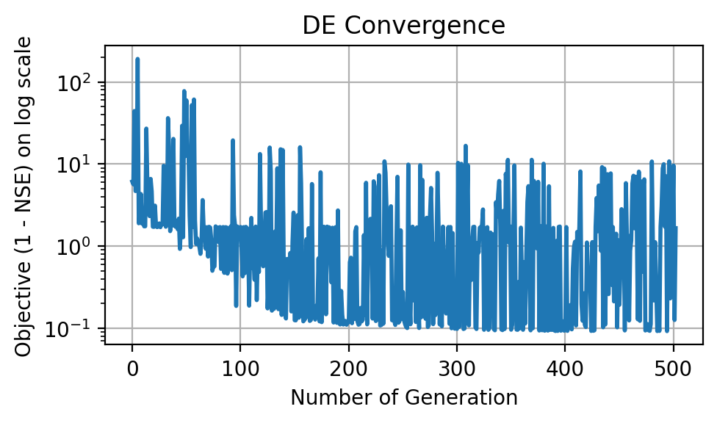
Parameter Optimization
All Parameters On
NSE: 0.901
Stabilizing: ~ 100 Iterations

Slide 5
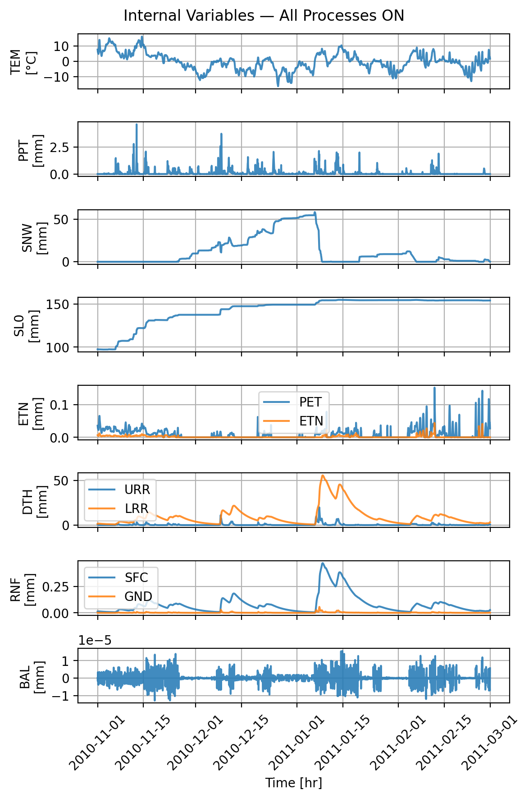
Parameter Optimization
All Parameters On
Snow initial depth: 0.000000
Snow fall/melt temperature: 0.148940
Snow melt air factor: 0.634415
Precipitation melt air factor: 0.036731
Soil initial moisture: 94.568525
Soil permanent wilting point: 432.979200
Soil field capacity: 148.866130
Soil beta: 2.659653
Storage initial upper reservoir: 1.728010
Storage initial lower reservoir: 0.739939
Upper-res. runoff split ratio: 0.748241
Percolation coefficient upper-to-lower: 0.185272
Upper-res. threshold depth: 60.579322
Upper-res. threshold coefficient: 0.143289
Upper-res. discharge to runoff coefficient: 0.000401
Upper-res. Runoff coefficient: 0.000147
Discharge rate: 0.008535
Lower-res. runoff coefficient: 0.000024

Slide 6
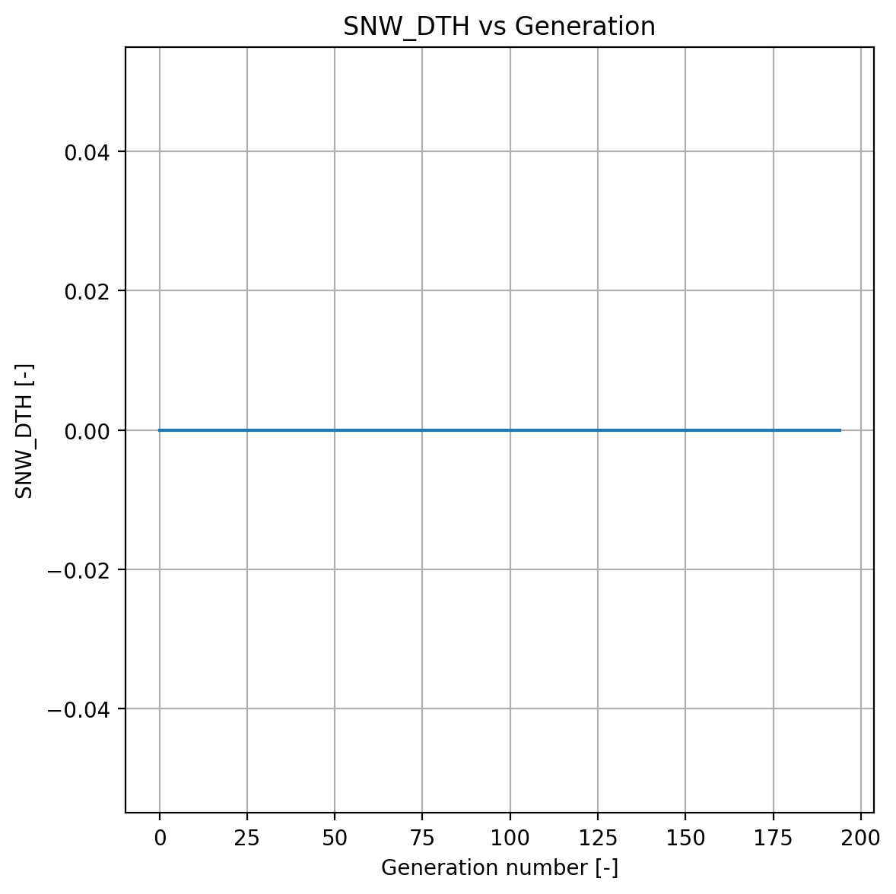
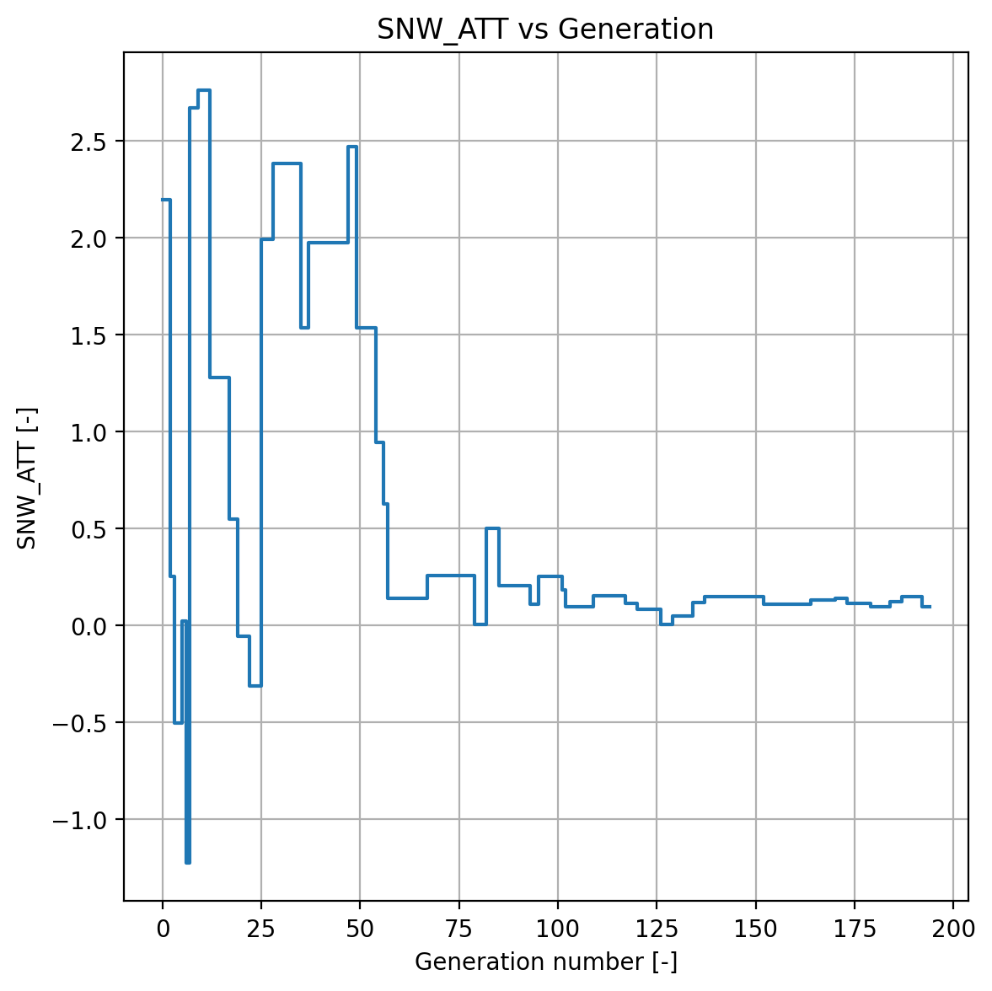

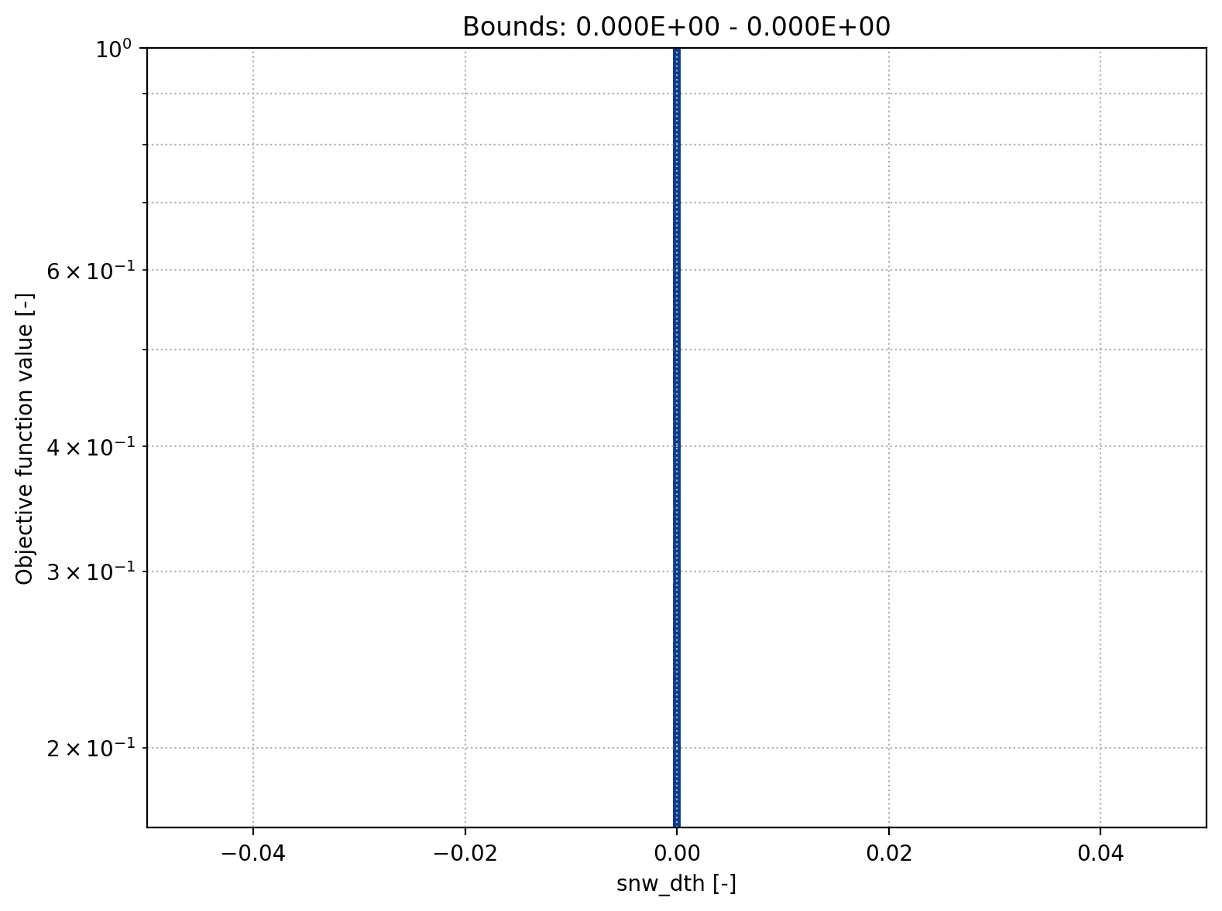
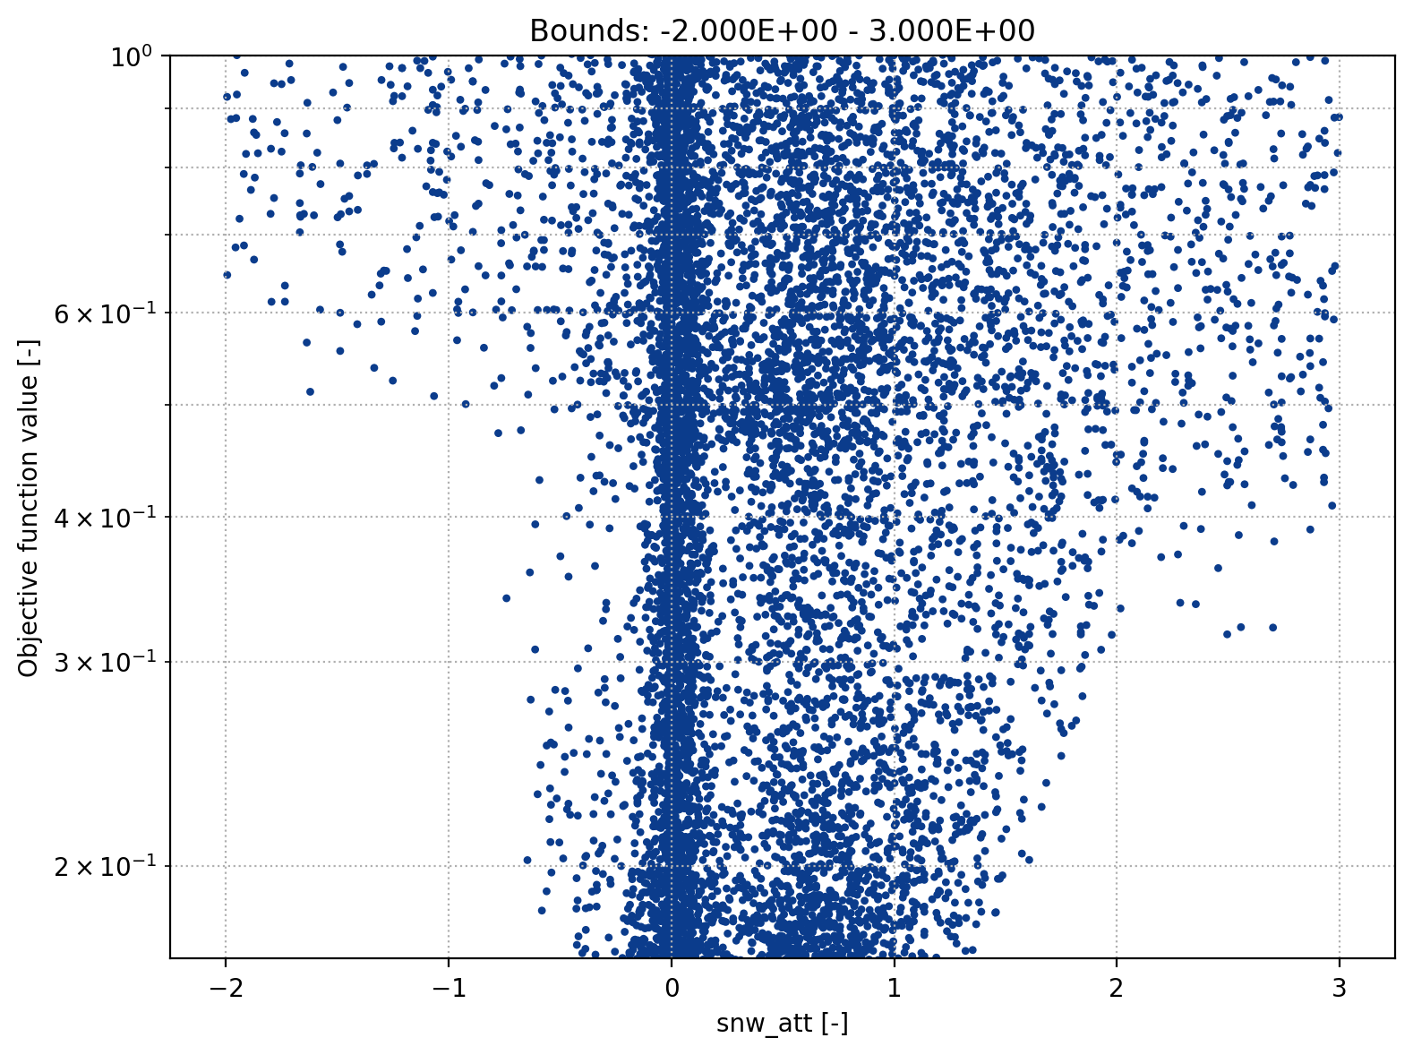
Parameter Optimization
Snow Module
Snow fall/melt temperature threshold
Snow initial depth

Slide 7
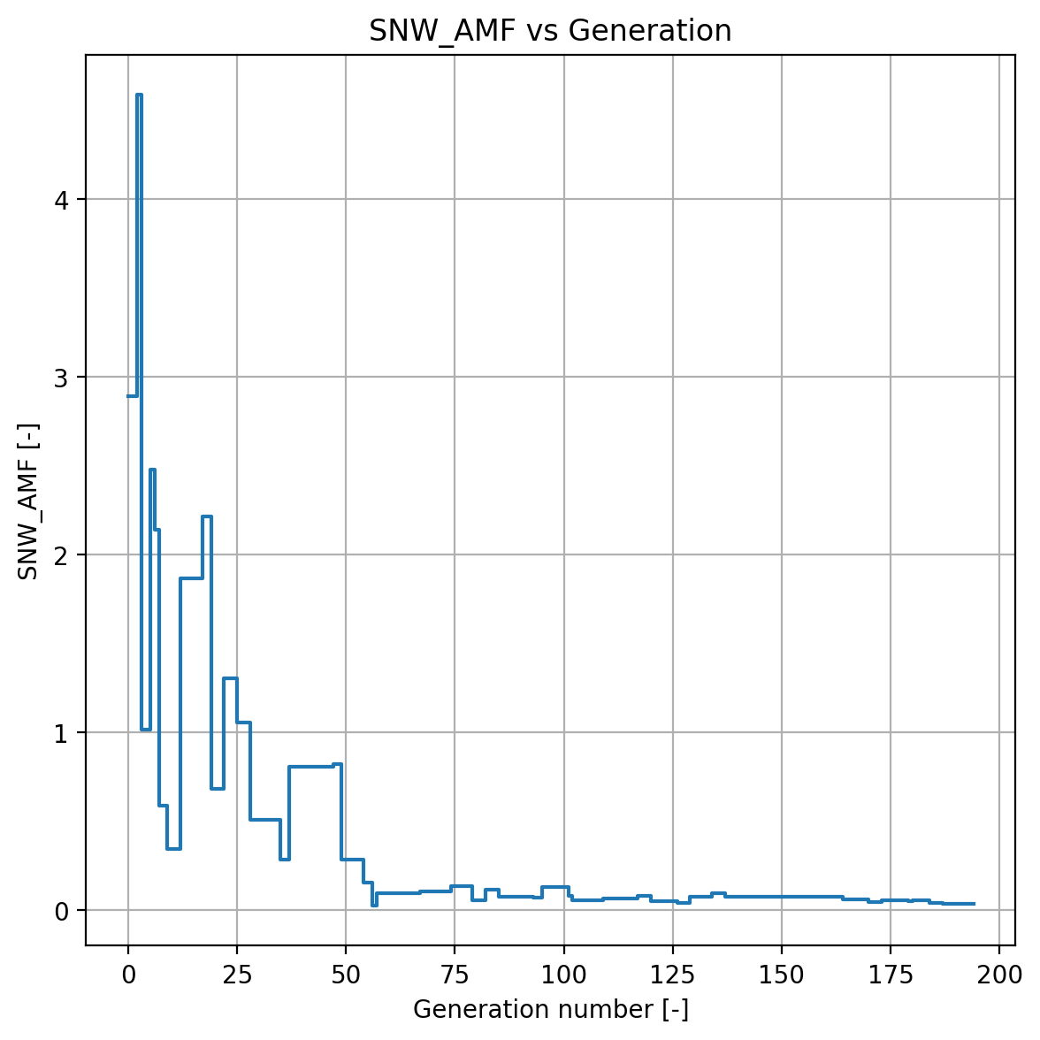
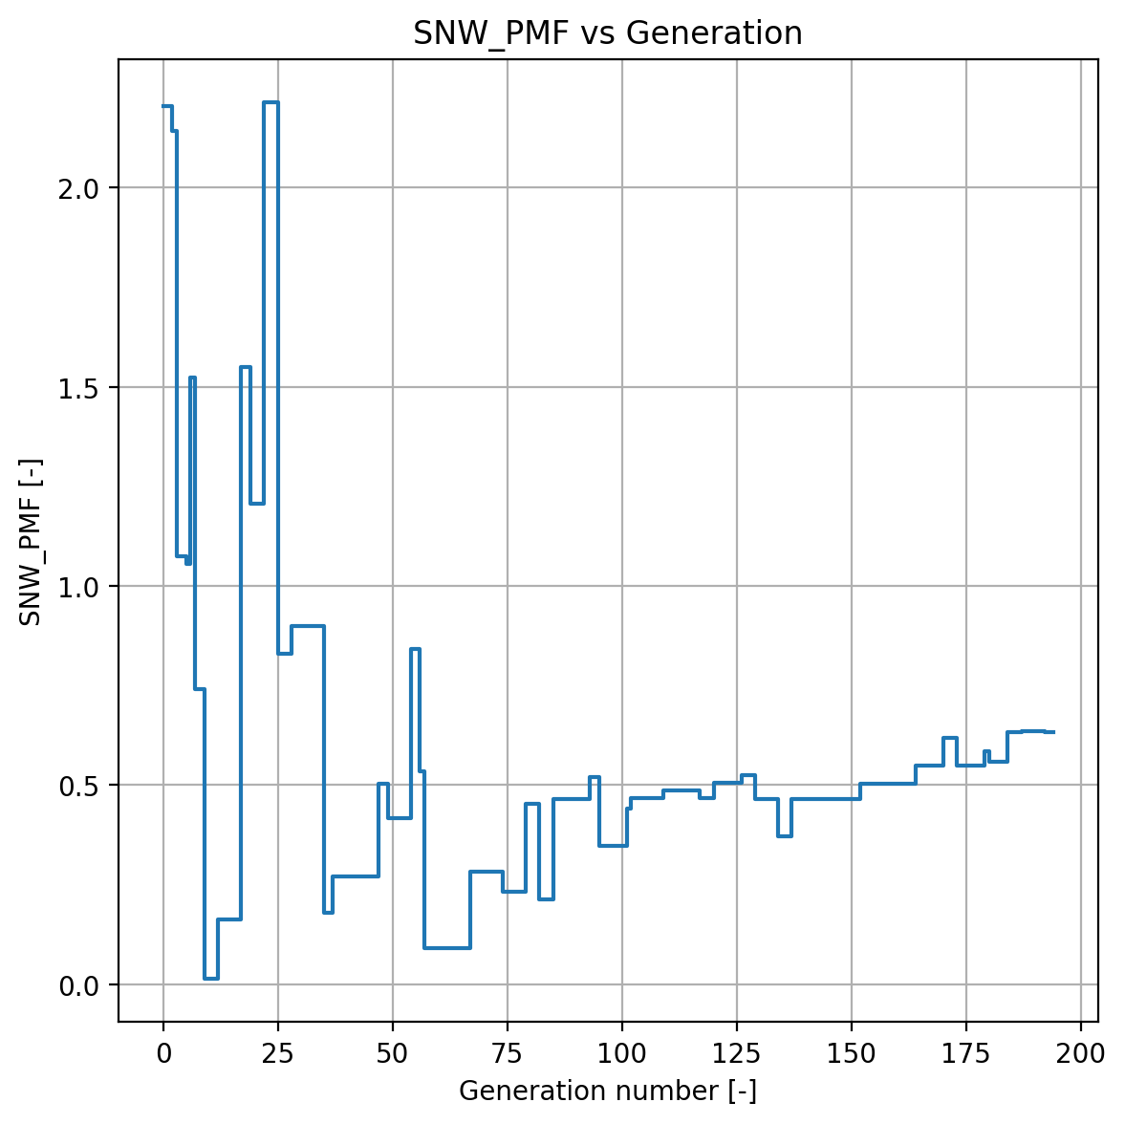
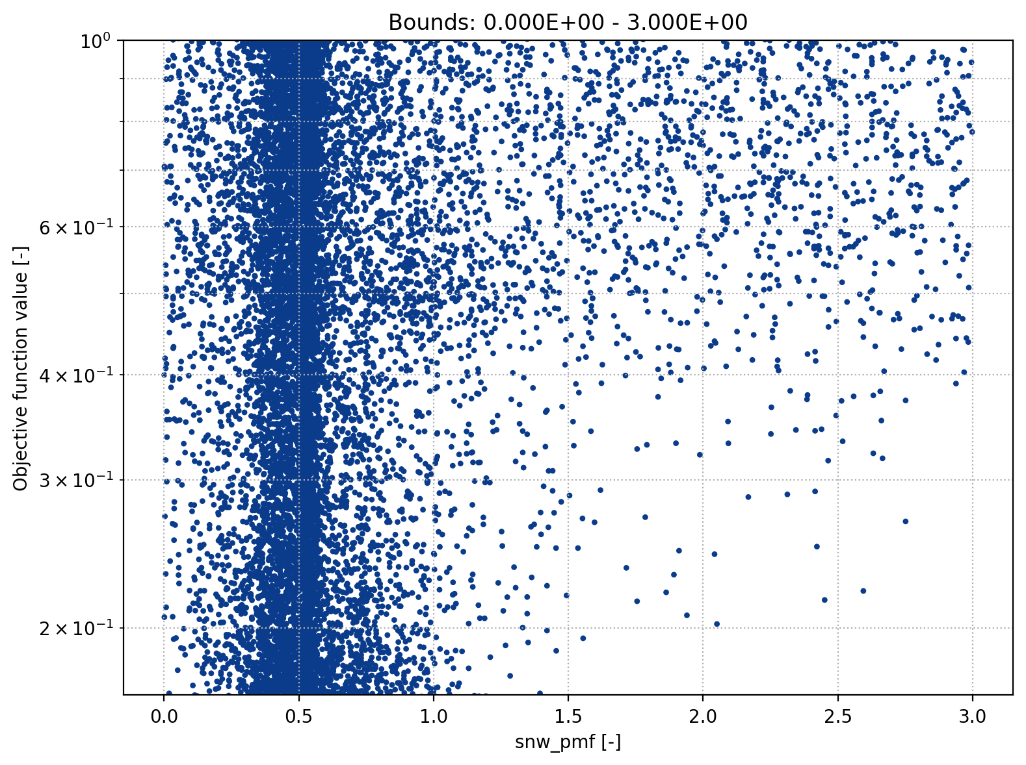
Parameter Optimization
Snow Module
Precipitation melt air factor
Snow melt air factor

Slide 8
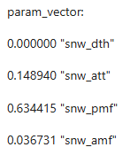
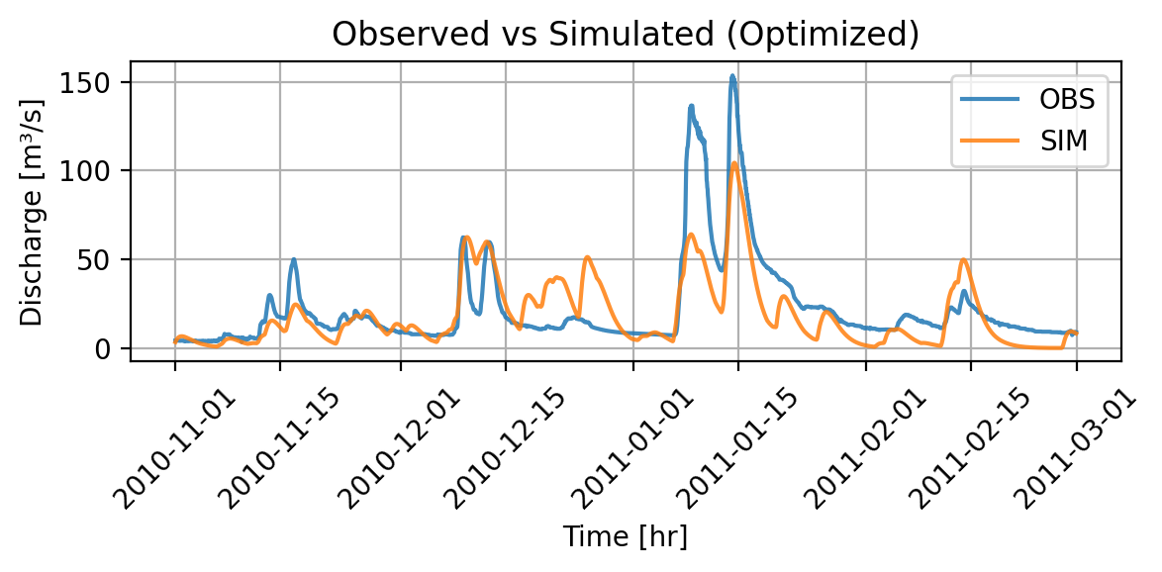

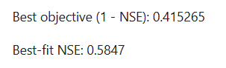
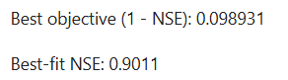
Parameter Optimization
Snow Module Off – Optimization Part 1
We set TT = -100°C
We set AMF = PMF = 0
Adapt bounds and run optimization
Simulated Discharge – snow modul off
Simulated Discharge – all modules on

Slide 9
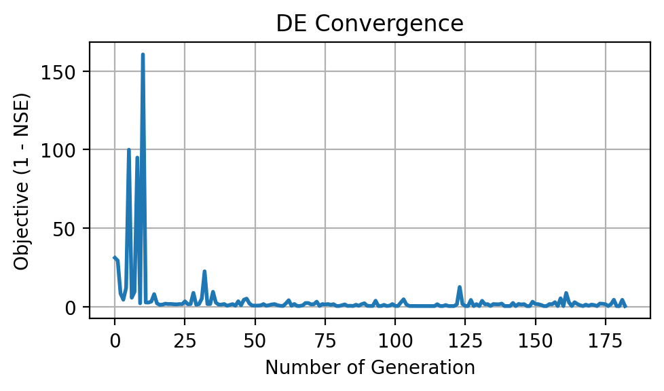
Parameter Optimization
Snow Module Off – Optimization Part 2
Schenkenau in Bavaria -> We expect melt
Less peaky as melt implies higher runoff
Interesting behavior (snow then no snow at fast melt)
High OFV
Poor convergence
Conclusion: Snow module relevant

Slide 10
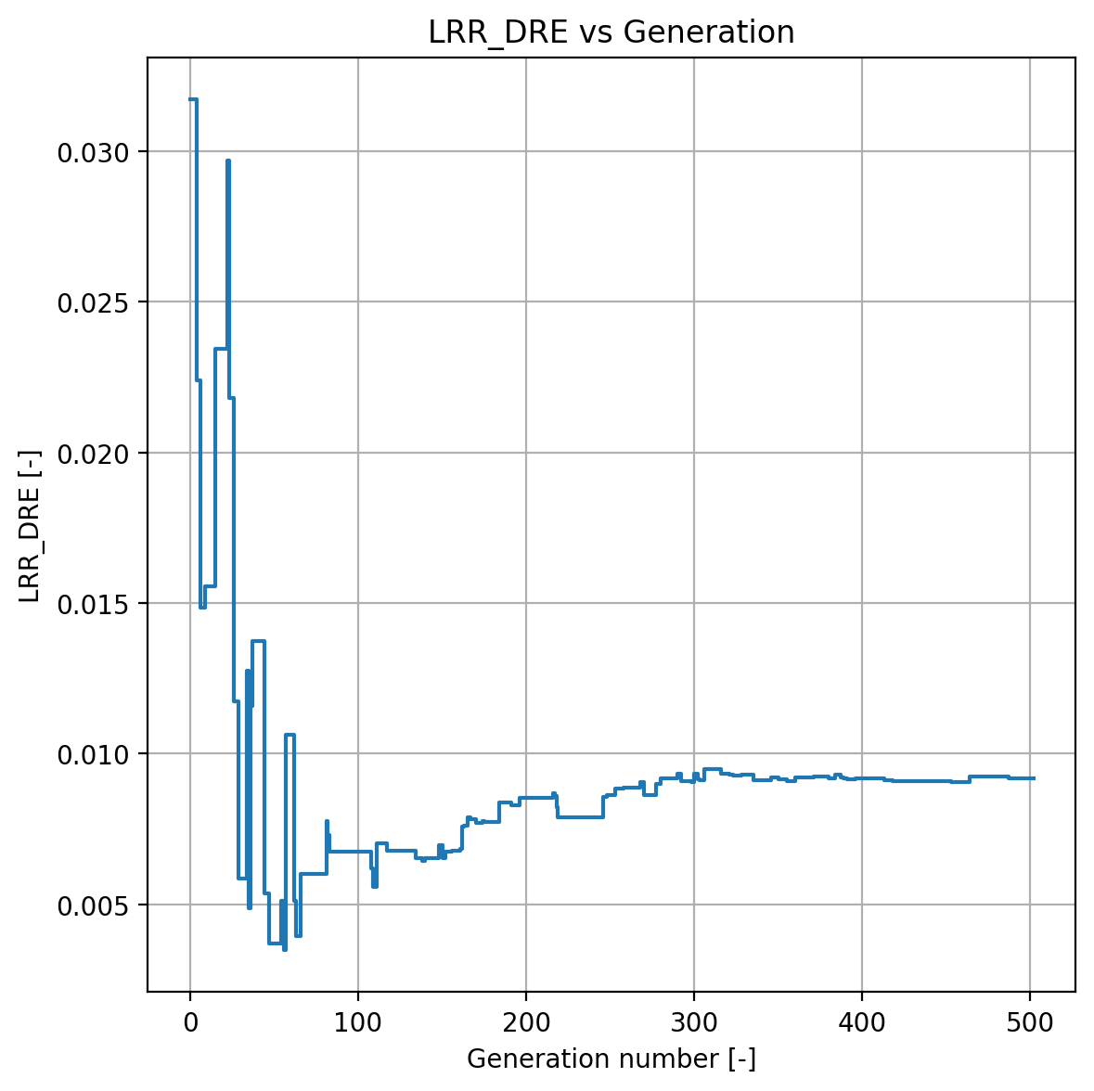
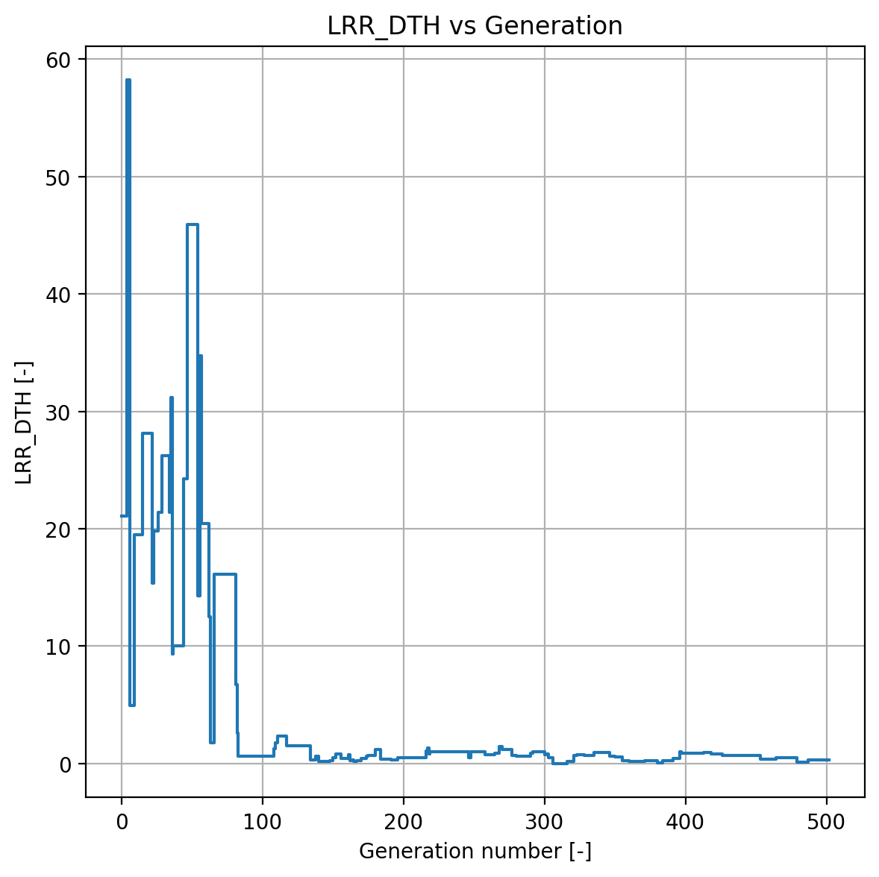
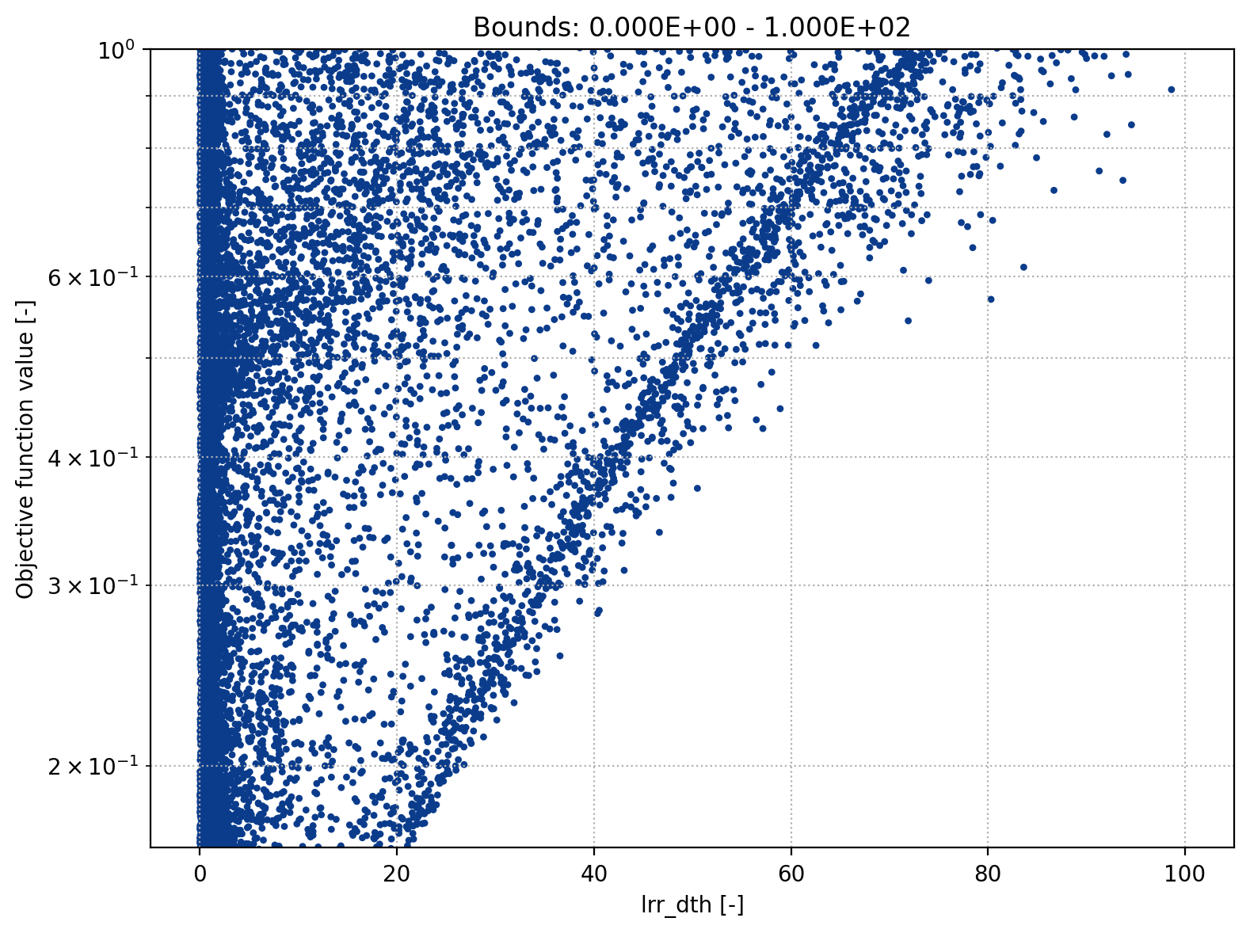
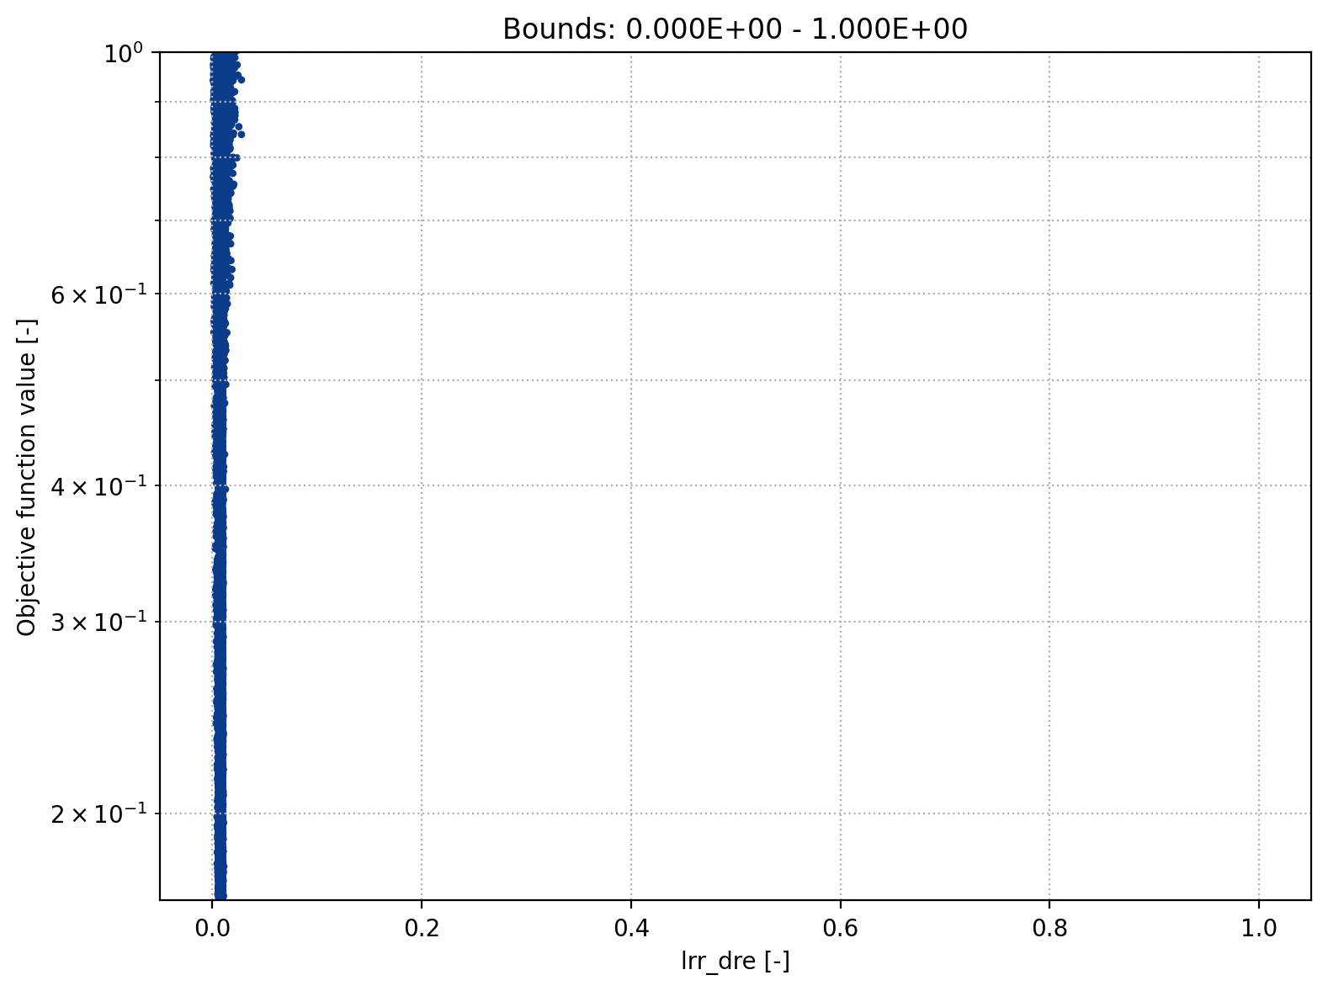
Parameter Optimization
Lower Reservoir Off
Discharge rate
Storage initial lower reservoir

Slide 11
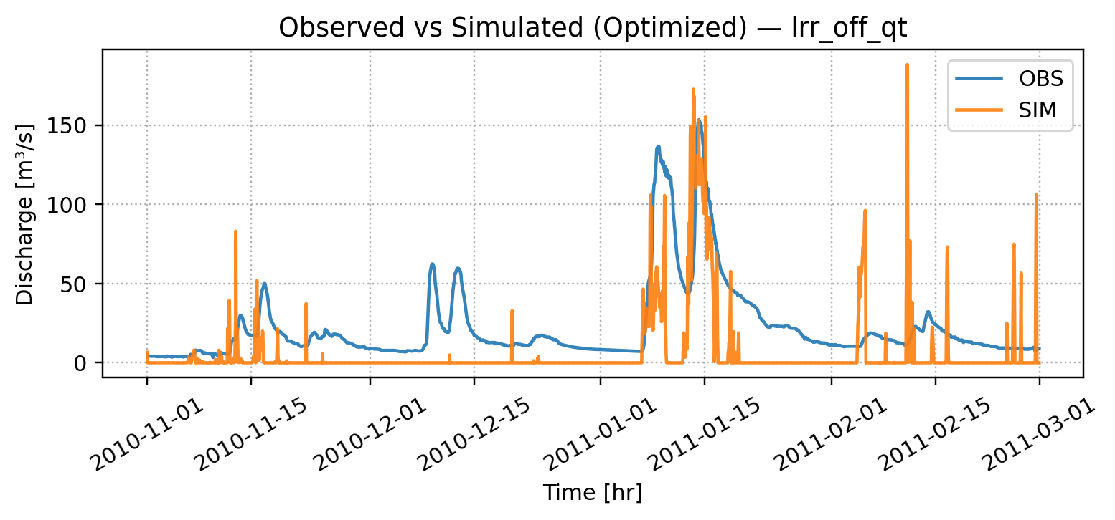
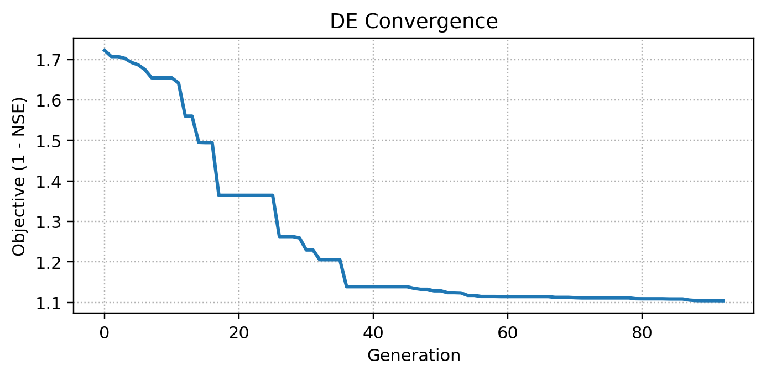
Parameter Optimization
Lower reservoir off
NSE: -0.1039
𝑄𝐿 = 𝐿𝑅𝑅_𝐷𝑇𝐻 × 𝐷𝑅𝐸 DRE = 0, ULC = 0, TDR = 1 (from the upper reservoir)
𝐿𝑅𝑅_𝐷𝑇𝐻 = 𝐿𝑅𝑅_𝐷𝑇𝐻 − 𝑄𝐿
𝐿𝑅𝑅_𝐷𝑇𝐻 = 𝐿𝑅𝑅_𝐷𝑇𝐻 + 𝑃𝐿𝑁

Slide 12
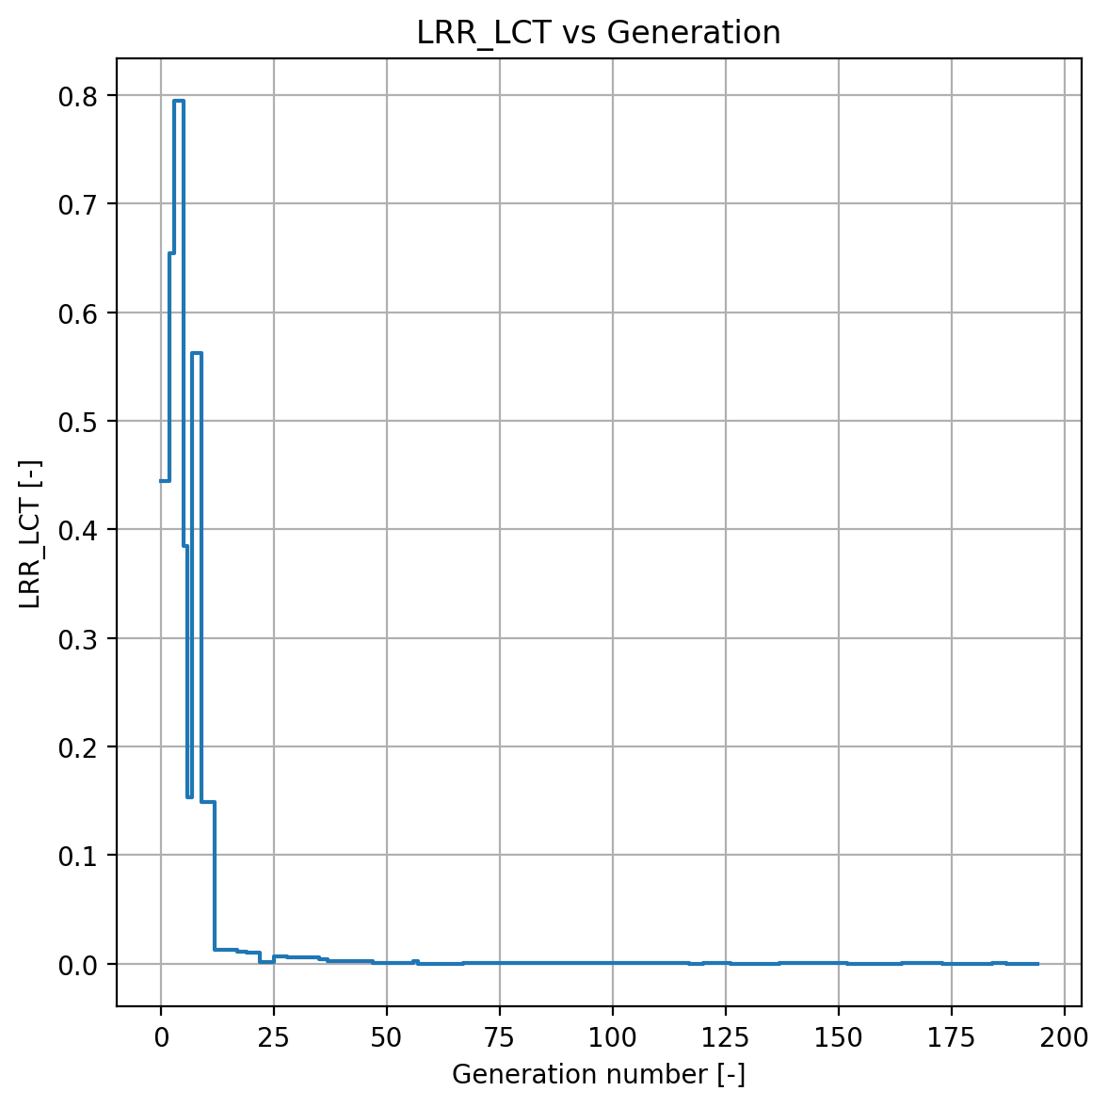
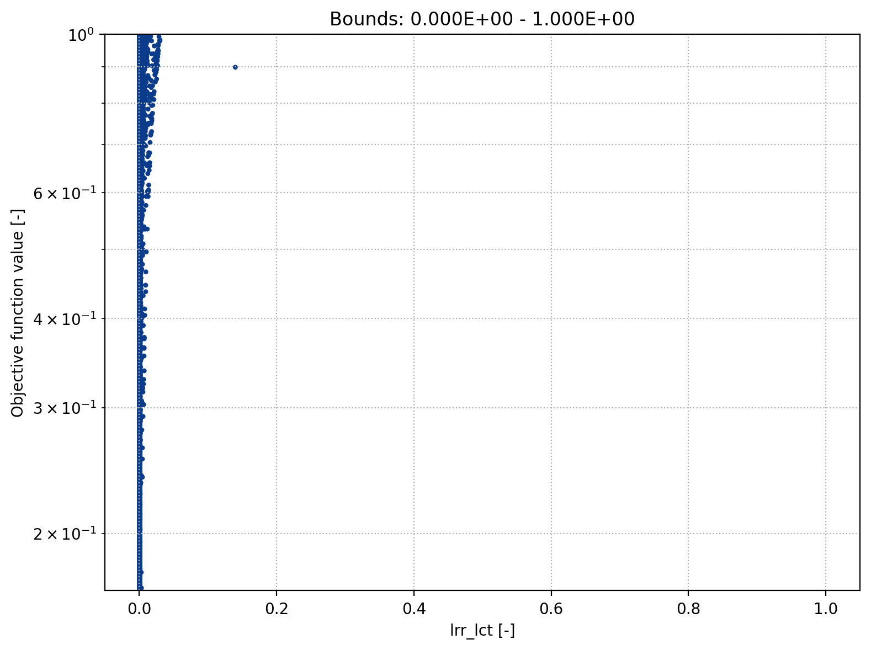
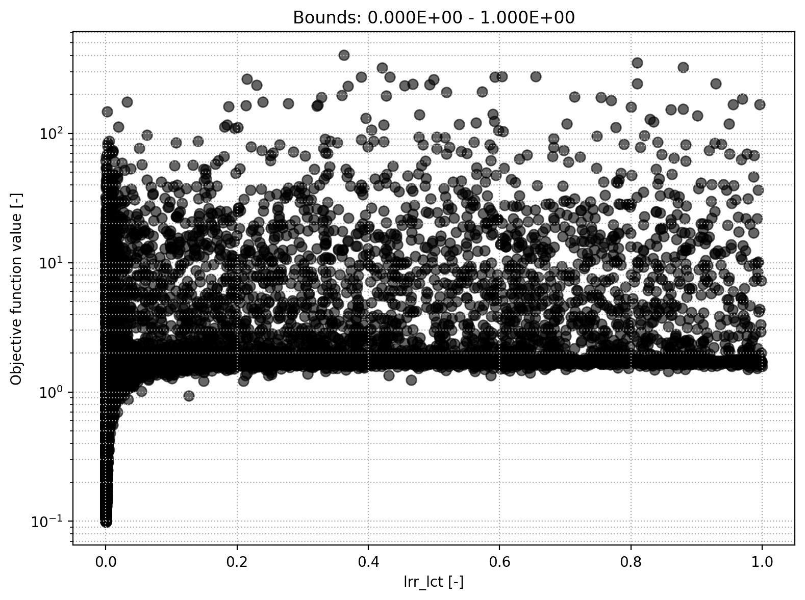
Parameter Optimization
Lower Reservoir Off
Lower-res. runoff coefficient

Slide 13
Local Sensitivity Analysis

Slide 14
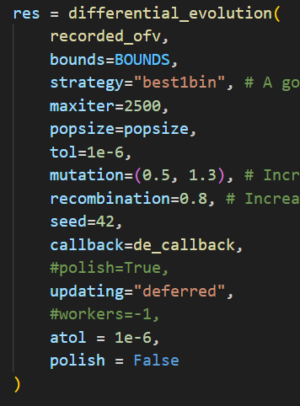
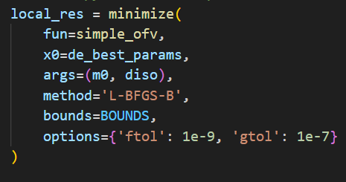
Preconsiderations
Updated First Assignment
Adaption of previous errors to allow for better local sensitivity analysis
Logarithmic and clipped y-axis
Maximal evaluations up to 60 000
Adjusted tolerances
More exploration (mutation & recombination)
Initial parameter adapted
Minimization method

Slide 15
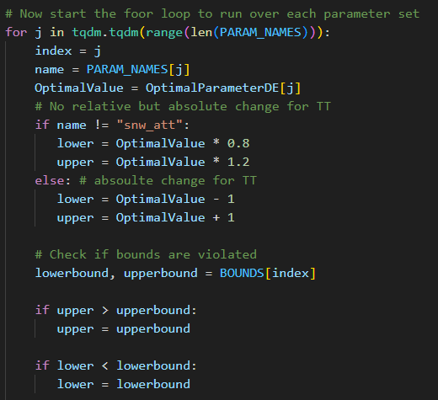
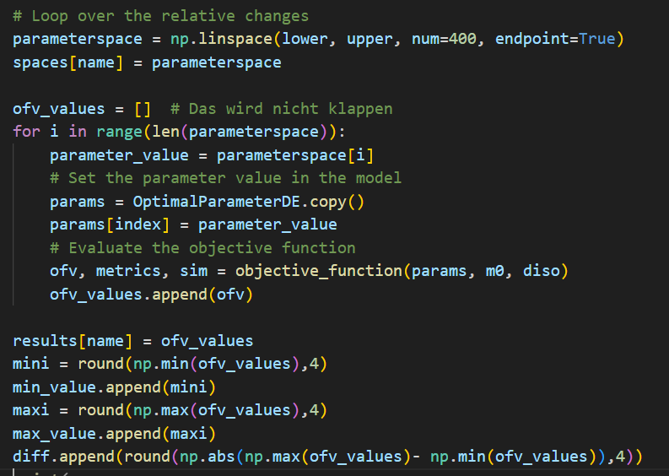
Local Sensitivity Analysis
Implementation

Slide 16
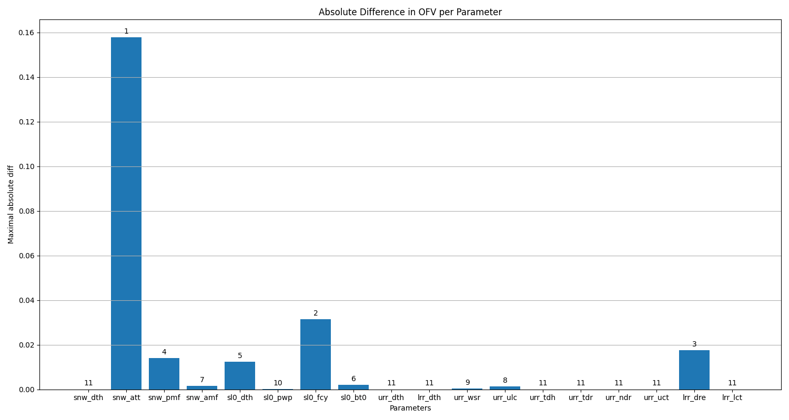
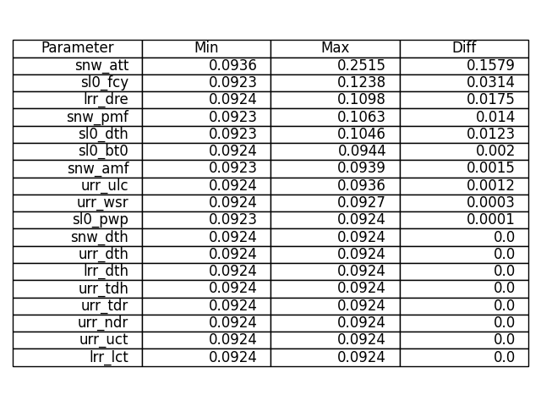
Local Sensitivity Analysis
Result – 20% deviation

Slide 17
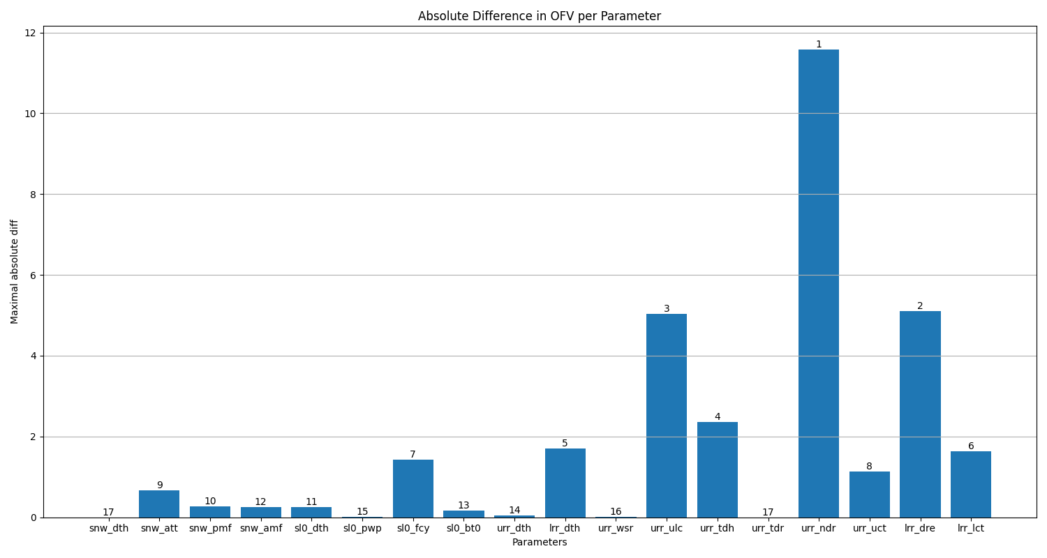
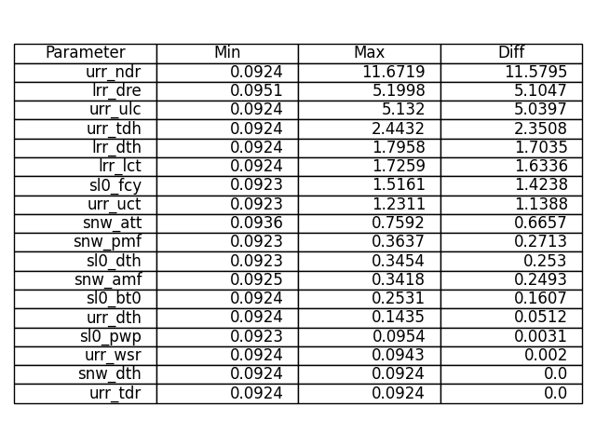
Local Sensitivity Analysis
Result – whole boundaries

Slide 18
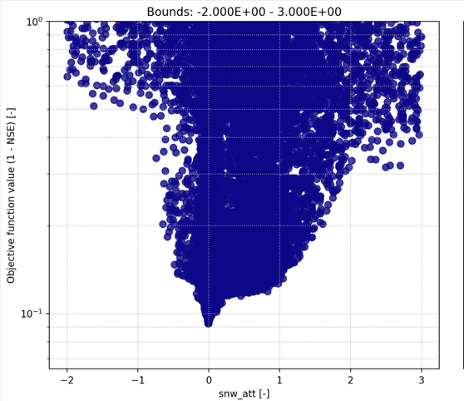
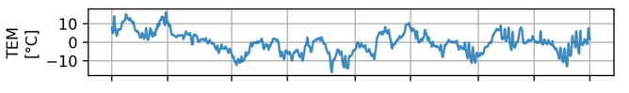
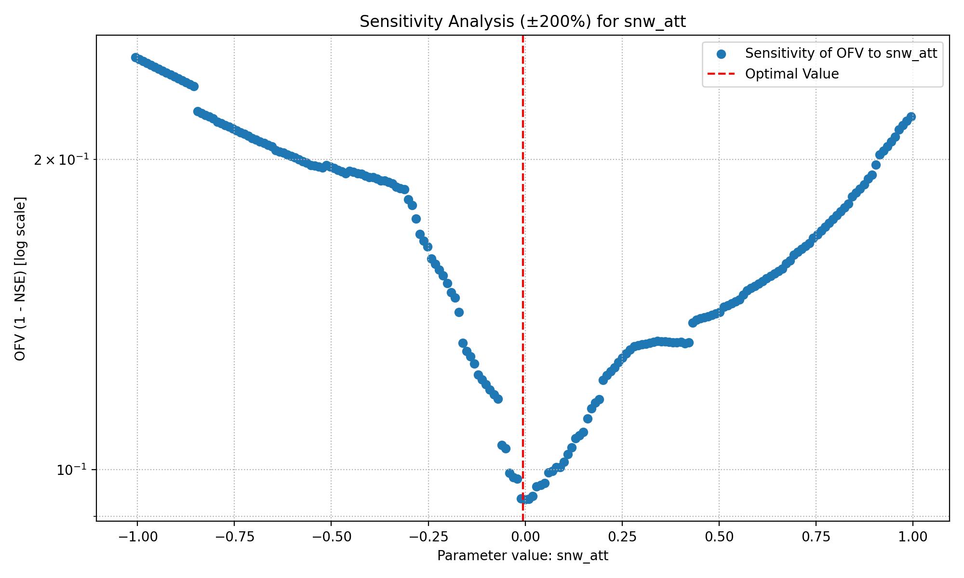
Local Sensitivity Analysis
Snow Fall/Melt Temperature Threshold

Slide 19
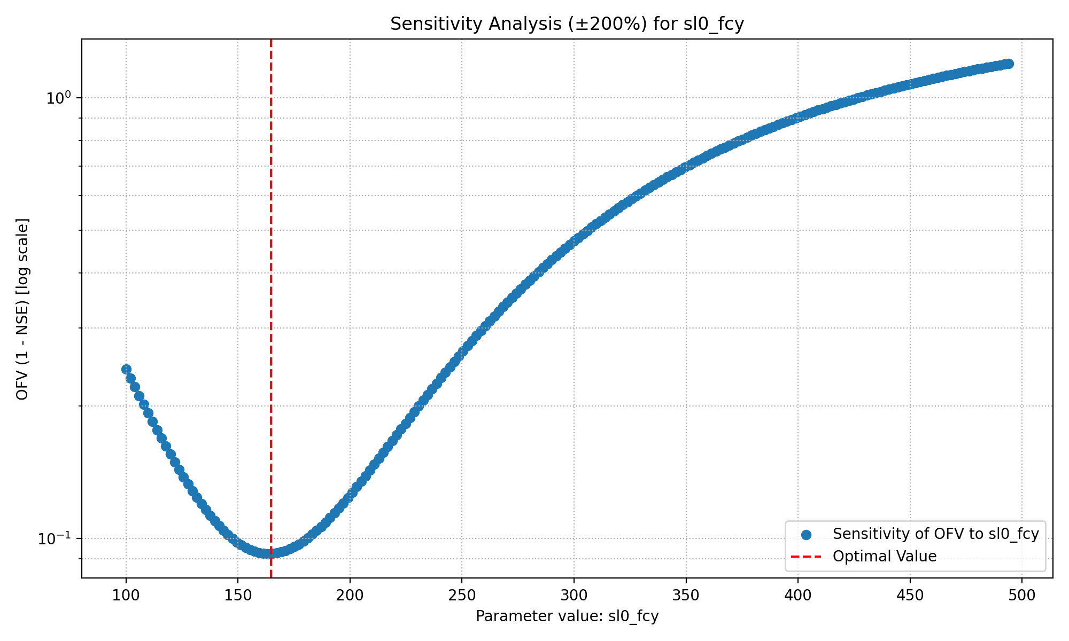
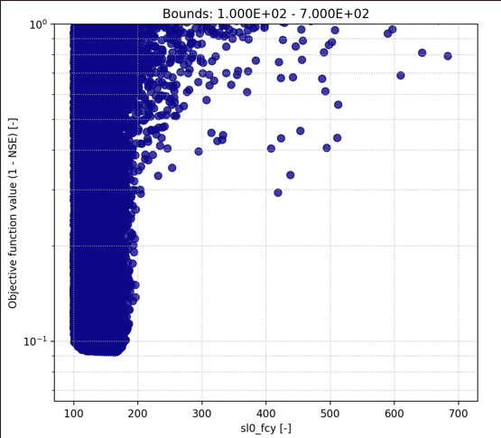
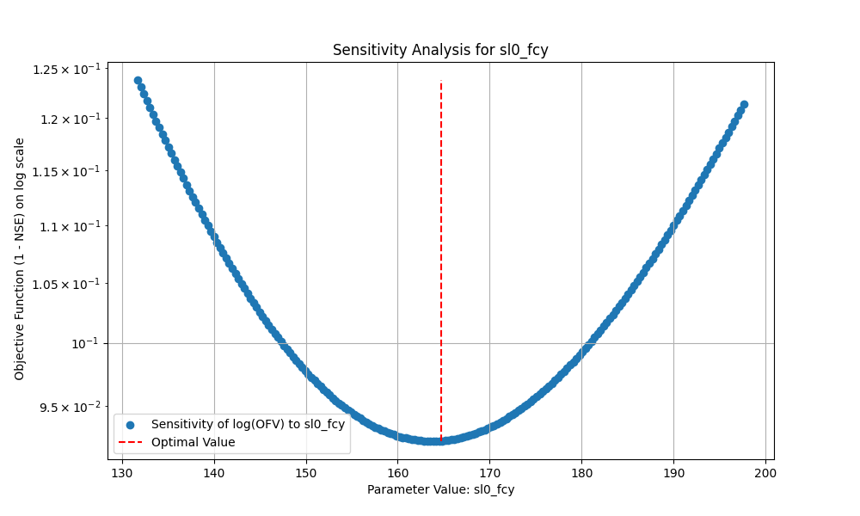
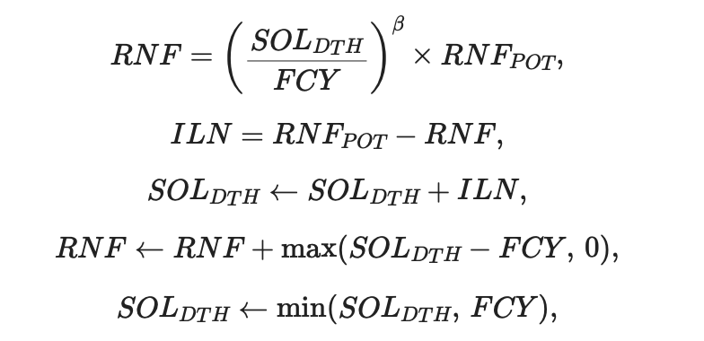
Local Sensitivity Analysis
Soil Field Capacity

Slide 20
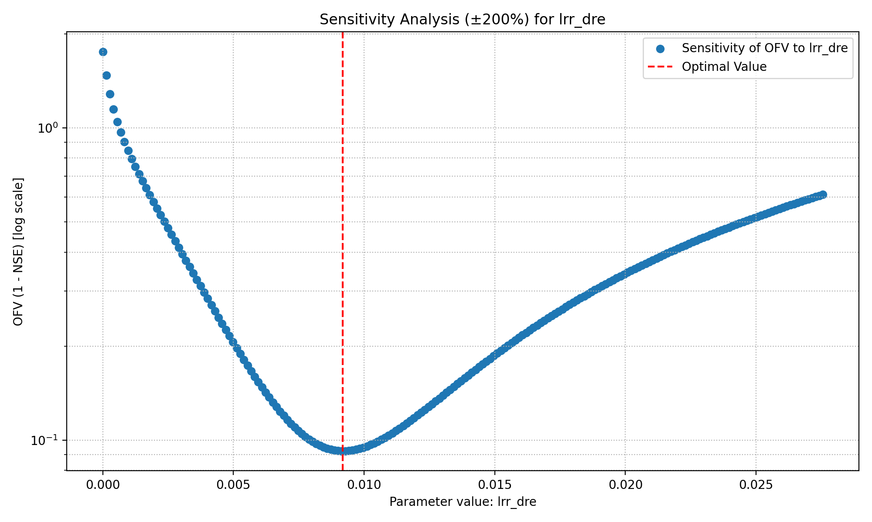
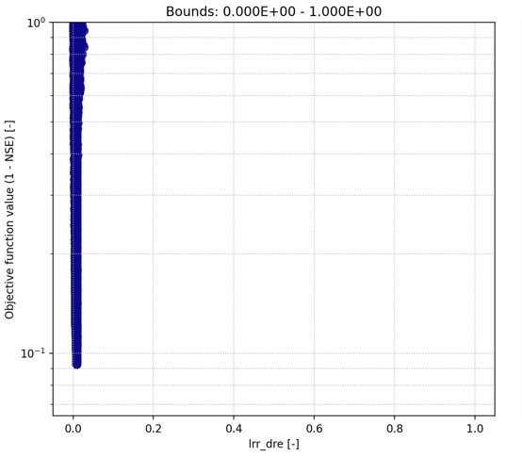
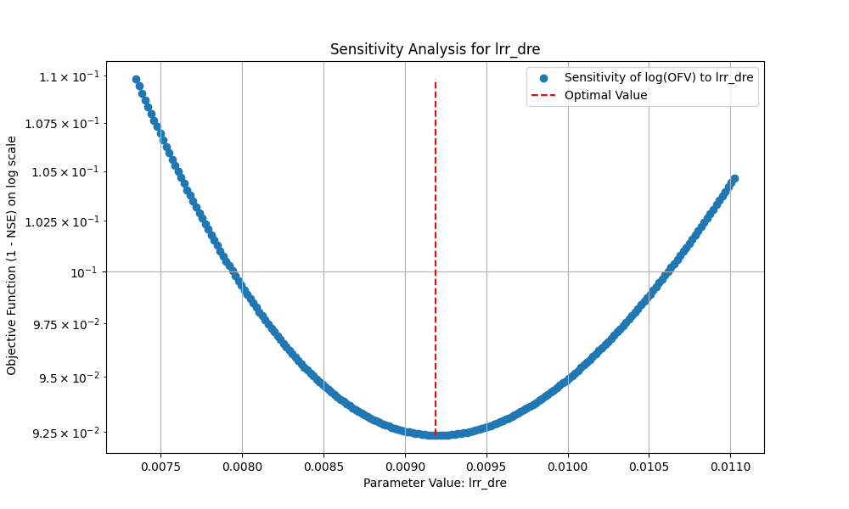
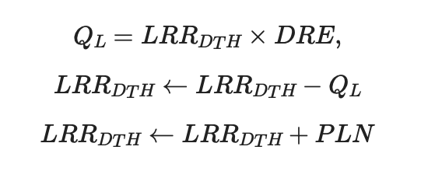
Local Sensitivity Analysis
Discharge Rate

Slide 21
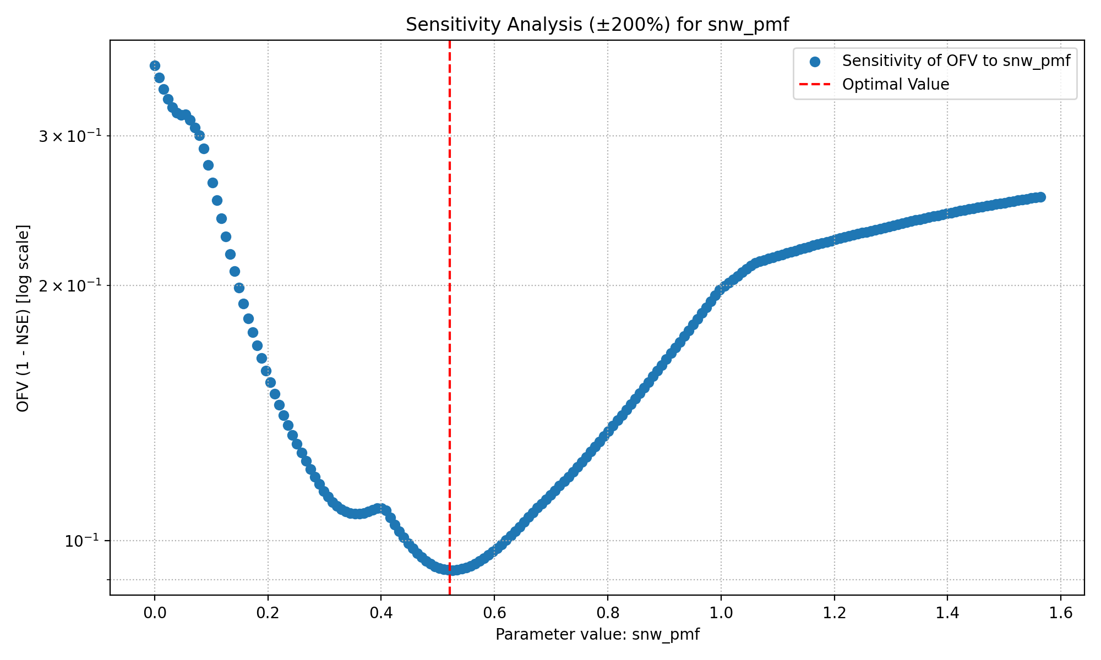
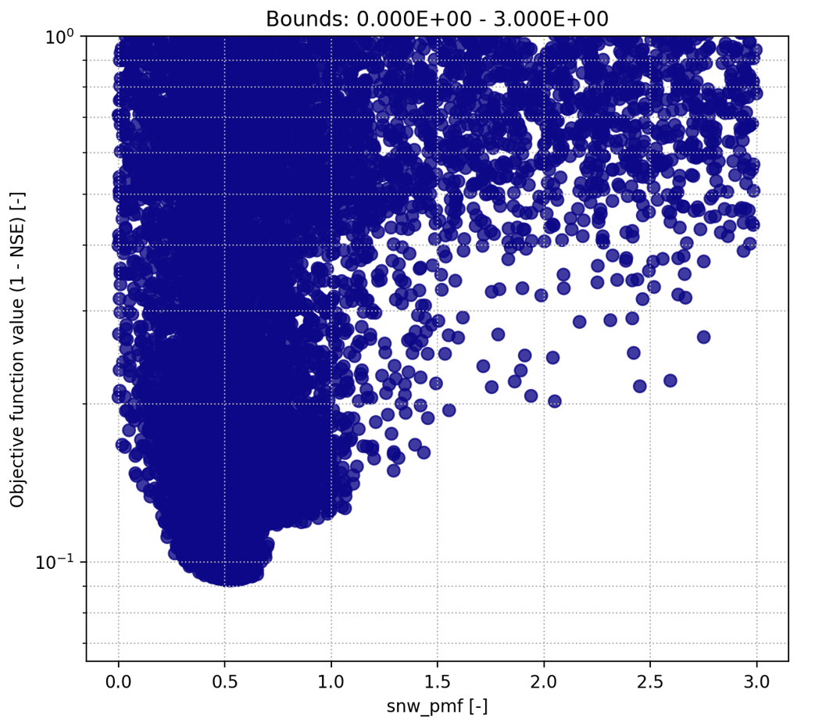
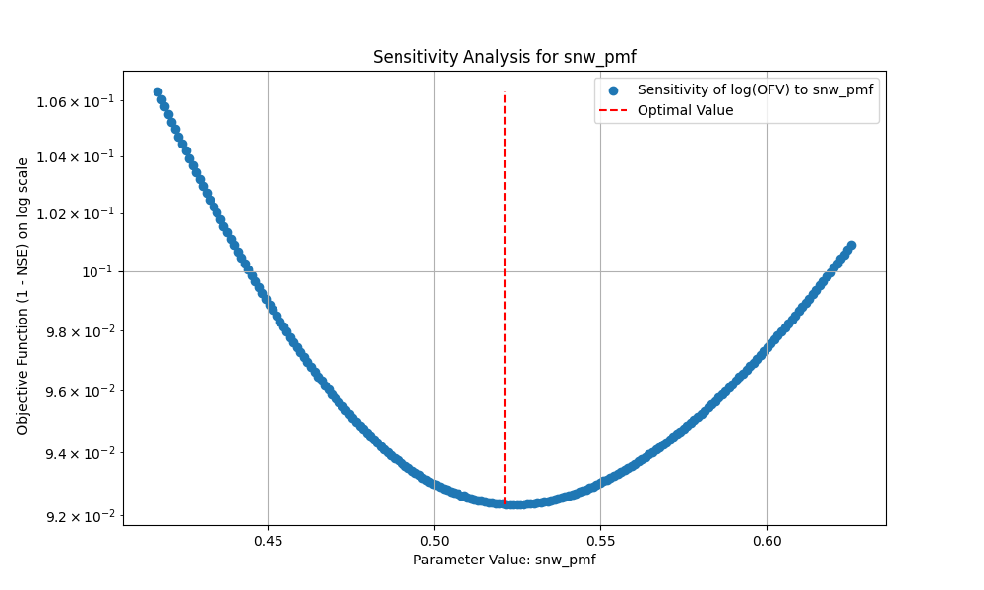
Local Sensitivity Analysis
Precipitation Melt Factor

Slide 22


Trying to make a sensitive parameter not sensitive
Precipitation Melt Factor (PMF)
Describes the amount of snow melt induced by precipitation (if it rains, snow melts faster)
We still want to account for the effect that precipitation in form of rain increases melt
Suggestion:
$$PMF= \frac{PPT}{SNW_{DTH}+ε}$$
PMF does not play a role anymore
If PPT small but SNW_DTH high => less contribution to MELT
If PPT high(low) and SNW_DTH high(low) , i.e. the same => will be around 1, i.e. PPT does not melt whole snow instantely (PPT does not affect the melt much)
If PPT high and SNW_DTH small => faster melt (think of muddy snow in February/March)
If SNW_DTH = 0 no devision by zero and later on MIN(MLT,SNW_DTH) = SNW_DTH

Slide 23




Trying to make a sensitive parameter not sensitive
Precipitation Melt Factor (PMF)
20 % deviation

Slide 24




Local Sensitivity Analysis
Soil Depth

Slide 25



Local Sensitivity Analysis
Soil Beta
Idea to make it less sensitive:
-linearization, e.g. apply natural logarithm

Slide 26


Recall Assignment 1
Turning URR Module (fast surface flow) off had the least impact
WSR = 0
URR_TDH​ = very large (≈1000)
TDR=0, NDR=0
ULC=1
Result:
PLN=RNF,Q_T=0,Q_N=0
URR acts as a pass-through to LRR, with no direct quickflow.
NSE = 0.8874

Slide 27




Local Sensitivity Analysis
Percolation Coefficient Upper To Lower

Slide 28




Local Sensitivity Analysis
Upper Reservoir Threshold Depth

Slide 29
Global Sensitivity Analysis

Slide 30



Global Sensitivity Analysis
Setup Code

Slide 31


Global Sensitivity Analysis
Sobol Sampling

Slide 32

Global Sensitivity Analysis
Sobol Sampling

Slide 33

Global Sensitivity Analysis
Sobol Sampling

Slide 34


Global Sensitivity Analysis
Sobol Sampling

Slide 35


Global Sensitivity Analysis
Sobol Sampling

Slide 36

Global Sensitivity Analysis
Sobol Sampling

Slide 37

Global Sensitivity Analysis
Sobol Sampling

